Slide 1
Heart Disease Predict
Никита Усачёв, Сувернев Михаил, Тищенко Даниил

Slide 2

Project
Heart Disease is a prevalent and potentially life-threatening health issue worldwide. Various factors contribute to the development of heart disease, including high blood pressure, high cholesterol levels, smoking, obesity, and a sedentary lifestyle.
We want to conduct a study of the dependence of heart disease on the main parameters of a person and, on the basis of the dependences identified in the process of studying, create a model capable of determining predisposition to the disease
Model that determines the predisposition to the disease

Slide 3
Dataset
Dataset taken from the Kaggle platform and data to take from examinations of patients
Features:
Age | Objective Feature | age | int (days)
Height | Objective Feature | height | int (cm) |
Weight | Objective Feature | weight | float (kg) |
Gender | Objective Feature | gender | categorical code |
Systolic blood pressure | Examination Feature | ap_hi | int |
Diastolic blood pressure | Examination Feature | ap_lo | int |
Cholesterol | Examination Feature | cholesterol | 1: normal, 2: above normal, 3: well above normal |
Glucose | Examination Feature | gluc | 1: normal, 2: above normal, 3: well above normal |
Smoking | Subjective Feature | smoke | binary |
Alcohol intake | Subjective Feature | alco | binary |
Physical activity | Subjective Feature | active | binary |
Presence or absence of cardiovascular disease | Target Variable | cardio | binary |

Slide 4
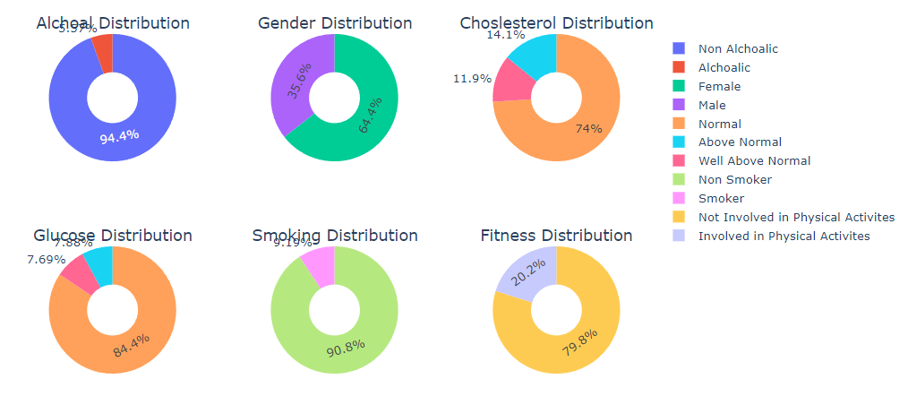
Dataset

Slide 5

Data cleansing
1) Remove duplicate data by removing the id of people (24 people)
2) made a defect in blood pressure less than 250 mm Hg and more than 0
3) defect of systolic pressure less than 200 mm Hg and more than 0
After the second and third it took 3180.

Slide 6
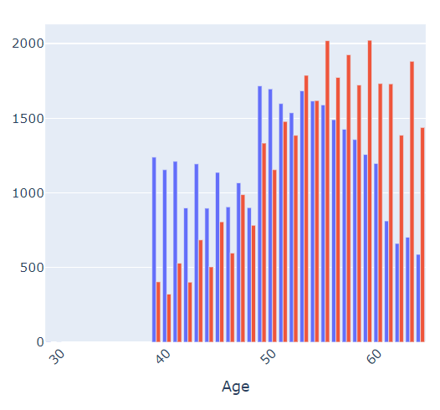
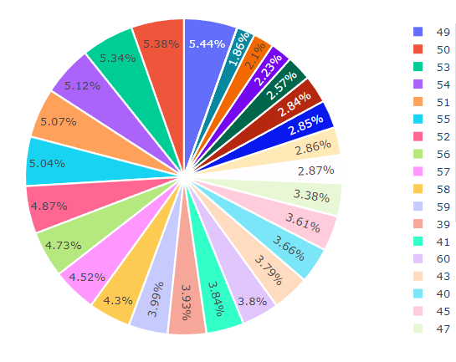
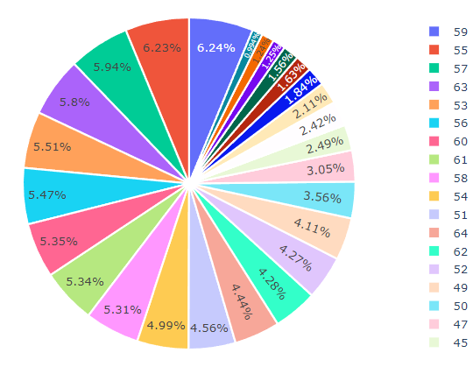
Age distribution from the target trait
healthy
not healthy
Young people have a lower chance of getting CVD
The older the age, the greater the chance of the disease

Slide 7
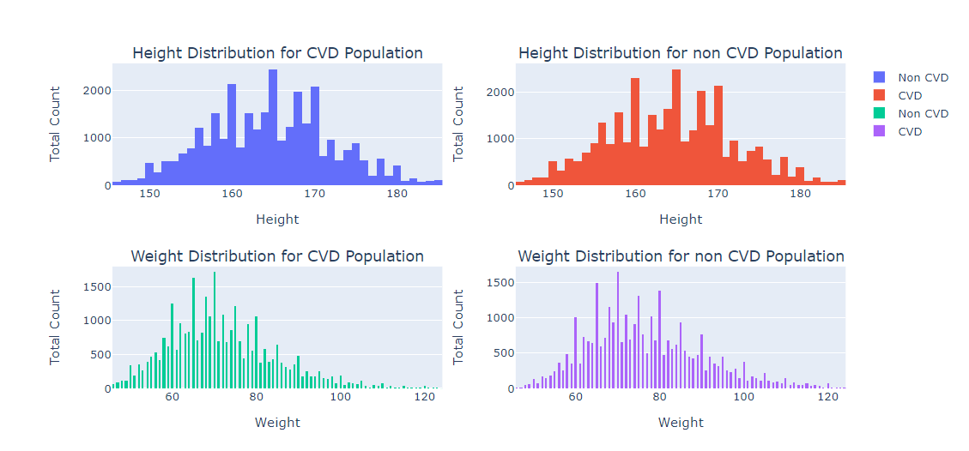

Slide 8
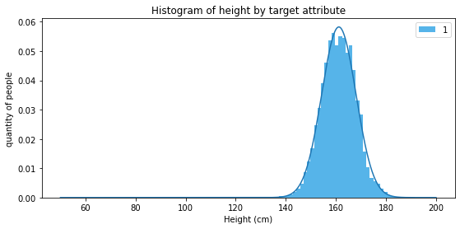

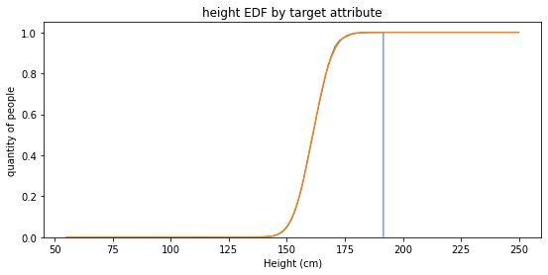
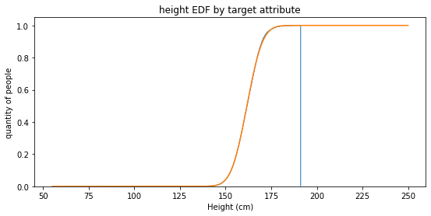
Height from target trait for women
healthy
not healthy
As you can see, the distributions in healthy and sick people coincide, based on this, we decided to move on to the study of BMI
KstestResult(statistic=0.011623511486409943, pvalue=0.0044467905890321555)
161.17244148848283 46.942538630555646
KstestResult(statistic=0.01234431782343548, pvalue=0.001865935087401986)
161.66891816404194 45.65852260742395

Slide 9
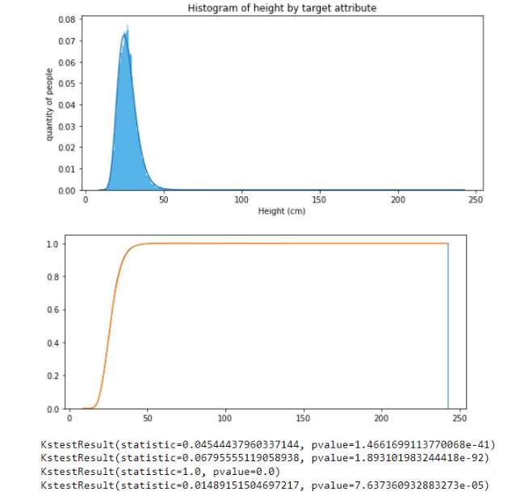
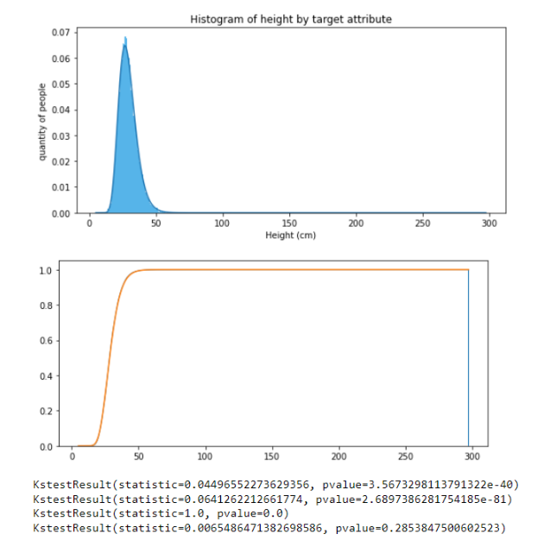
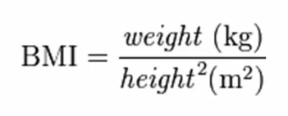


BMI of women from the target trait
healthy
not healthy
Turning to the study of BMI from the target trait, we realized that the distributions differ

Slide 10
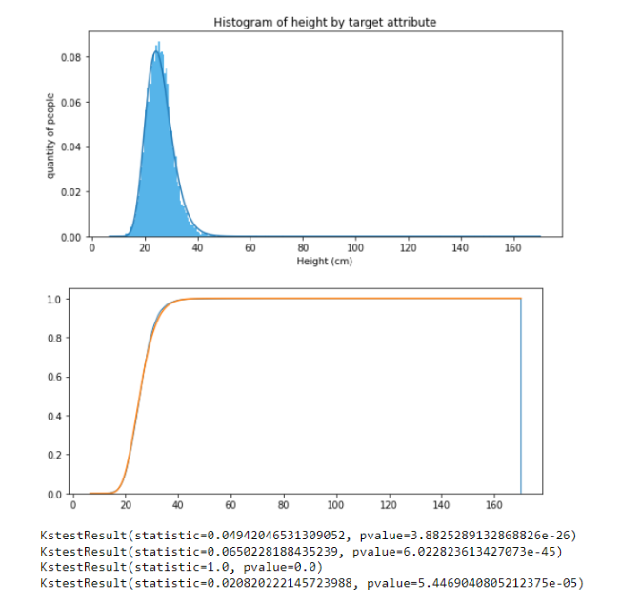
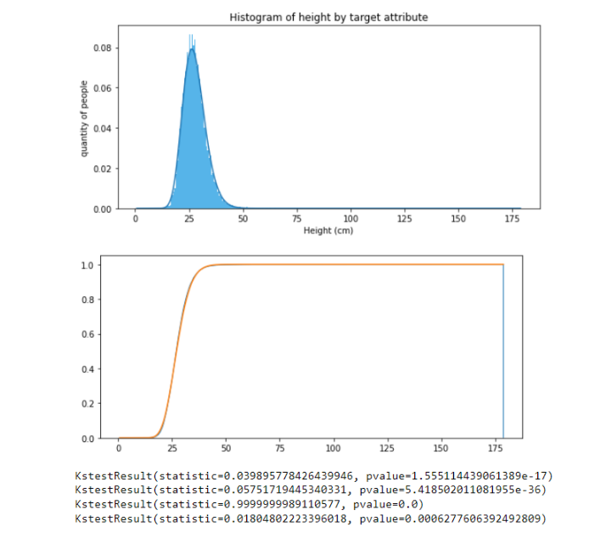


BMI of men from the target trait
Turning to the study of BMI from the target trait, we realized that the distributions differ
Gamma
Norm
Exp
Lognorm

Slide 11
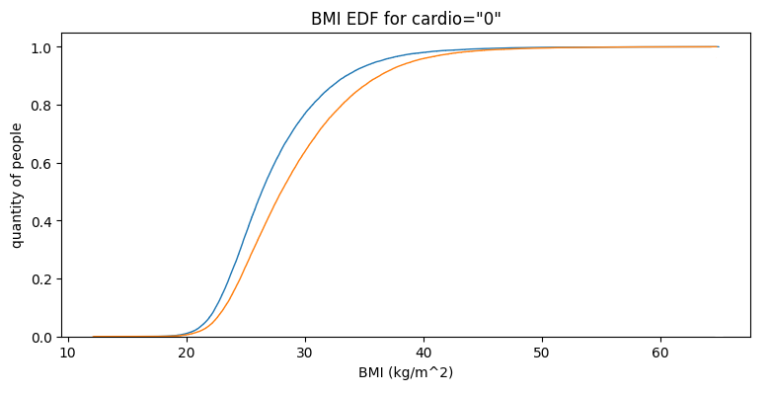
Empirical distribution function for BMI from the target trait
healthy
not healthy

Slide 12
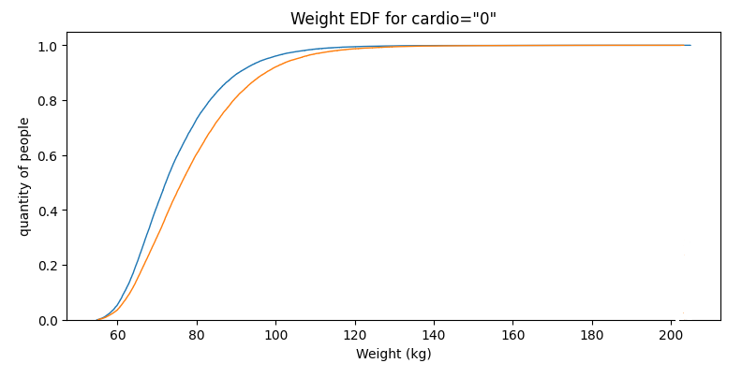
Empirical distribution function for the weight of the target trait
healthy
not healthy

Slide 13
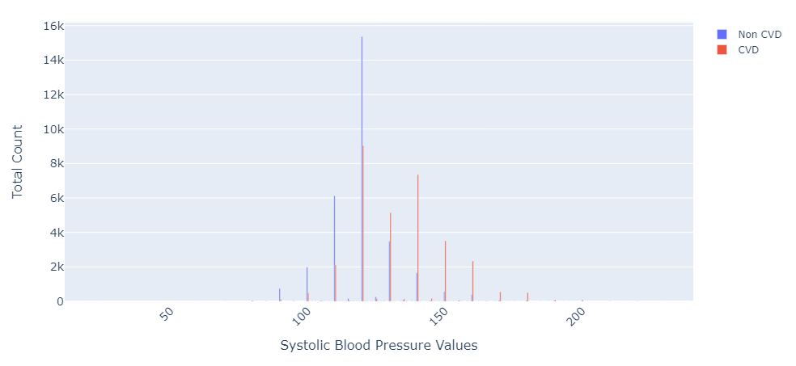
Distribution of ap_hi from the target feature

Slide 14
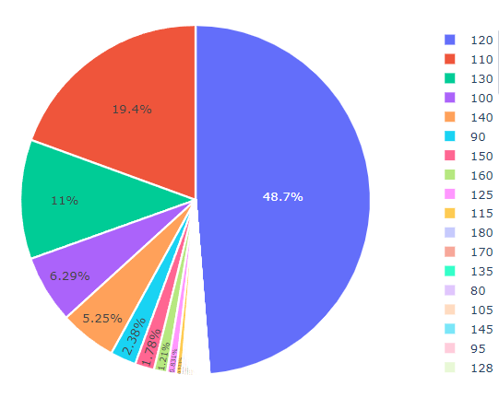
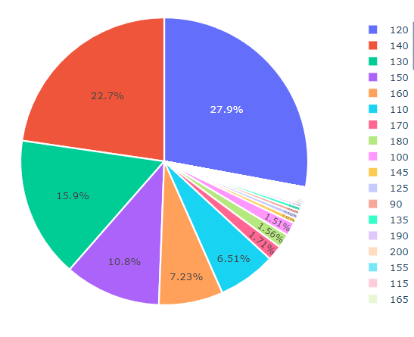
healthy
not healthy
The highest percentage of the population with blood pressure is 120
If a person does not have cardiovascular disease, he/she is more likely (48.7%) to have a systolic blood pressure of 120 mmHg

Slide 15
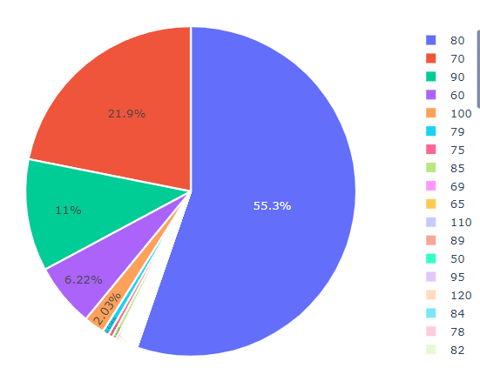
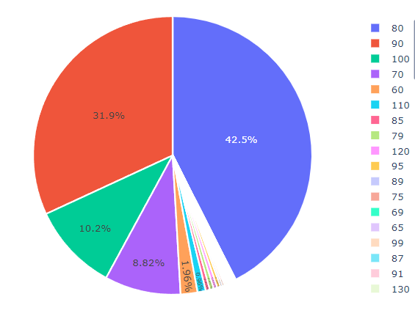
healthy
not healthy
Our dataset has the highest percentage of people with a diastolic blood pressure of 80 mmHg.

Slide 16
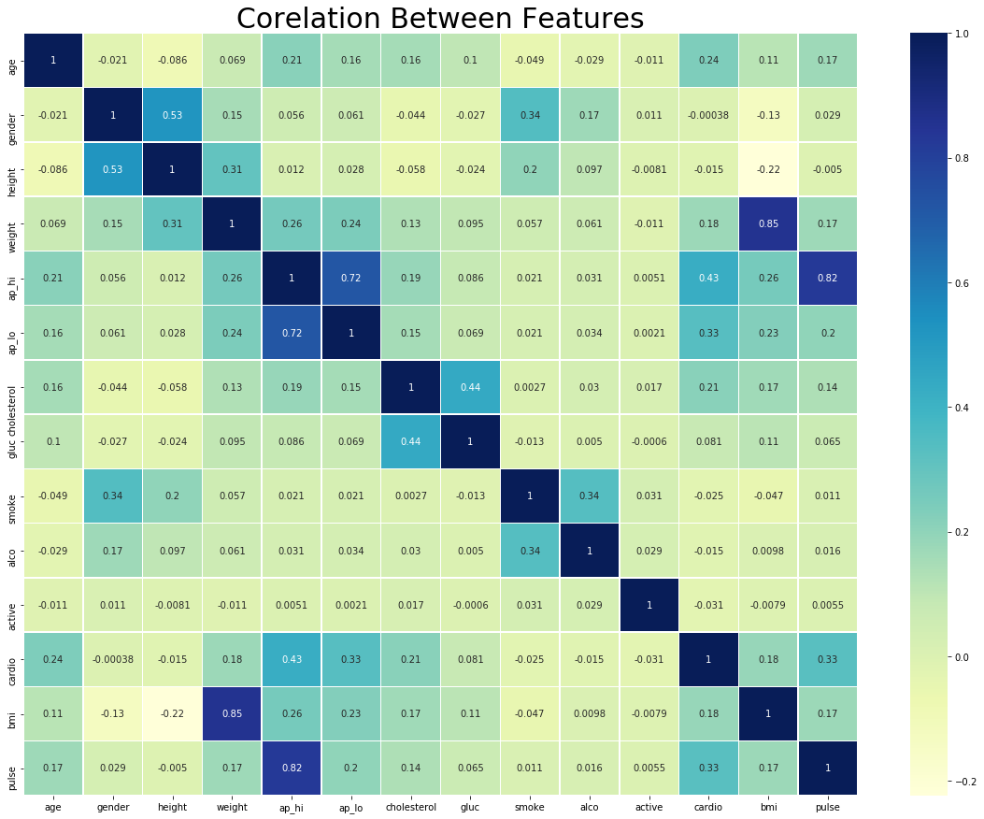
1)ap_hi ,cholesterol correlates with many traits but correlates the most with the target trait relative to other parameters.
2) we can draw the same conclusions about a person's age based on EGF and histograms, as well as BMI.
3) gender correlates with weight, height, smoking and alcohol, but does not correlate at all with the target trait; height, smoke, alco, active also correlate poorly
The following features were selected for further study: BMI, age, ap_hi, and cholesterol

Slide 17
Log.regression

Slide 18
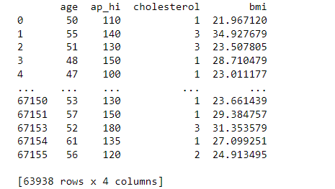
Data for regression
table with which we work further
31534 - the number of cases
32404 - the number of people with no disease

Slide 19
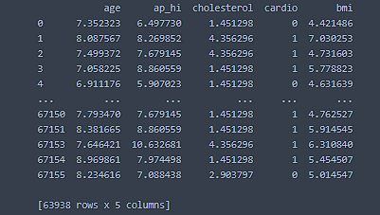
Data after centering and normalizing each parameter (we subtracted the empirical mean from each value from the column and divided by the root of the variance).

Slide 20
Log.regression: model quality
1) We divided our sample into 7/10 samples for training and 3/10 for model test
2) Then we built the error matrix and got that:
2.1) True positive predictions: 7278
2.2) True negative predictions: 6541
2.3) False positive predictions: 2168
2.4) False negative predictions: 3195
3) It turns out that we have 7278 + 6541 correct predictions and 2168 + 3195 false ones
4) We get that the accuracy of our logistic model is: 0.7204671045772078
5)
Equation: log(odds) = -11.3 + 0.126*bmi+0.323*age+0.018*ap_hi+0.288*chol
Conclusion: This tells us that the model made a correct prediction about whether the person is sick 71.9% of the time.

Slide 21
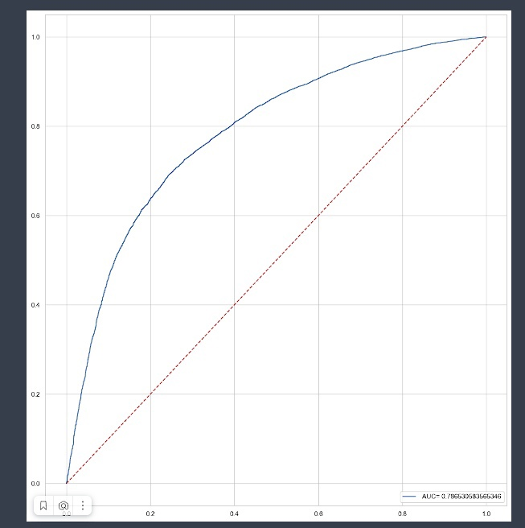
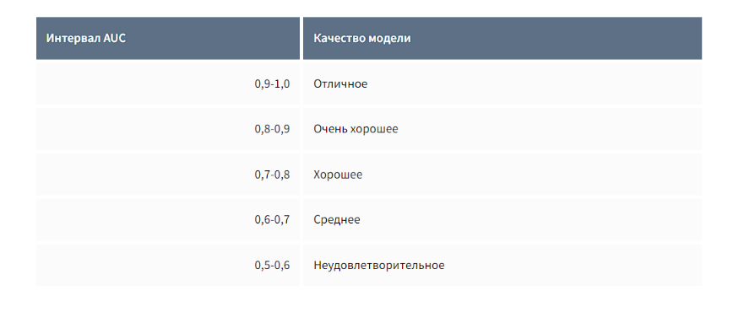
ROC - кривая
Receiver Performance Curve (ROC) is another popular tool used with binary classifiers. The dotted line represents the ROC curve of a completely random classifier. A good classifier stays as far away from it as possible (towards the upper left corner).

Slide 22
Выводы:
In the course of the work done, we realized that it is possible with known data about a person, namely his cholesterol level, age, upper blood pressure and body mass index, to find out a person's predisposition to a disease of the cardiovascular system.
we found a connection between the fact that if a person has a high body mass index, high cholesterol, high systolic pressure, and the older the person, the greater his predisposition to the disease. Things turned out to be pretty obvious, but this once again reminds us that we need to monitor our health.

